Slide 1
Trend Systems
Prof Michael ketzenberg

Slide 2
Agenda
Basic Buy and Sell Signals
Bands and Channels
Choosing the Trend Period
Techniques Using Two trend lines
Techniques using Three trend lines
Anticipating a Change in Trend
Projecting Moving Average Crossovers
Summary

Slide 3
Basic Buy and Sell Signals
All trends lag the price movement
Why?
When prices are going steadily up or down, the lag will be the largest.
The most common way to trade a moving average:
Buy when prices cross above the trend line.
Sell short when prices cross below the trend line.

Slide 4
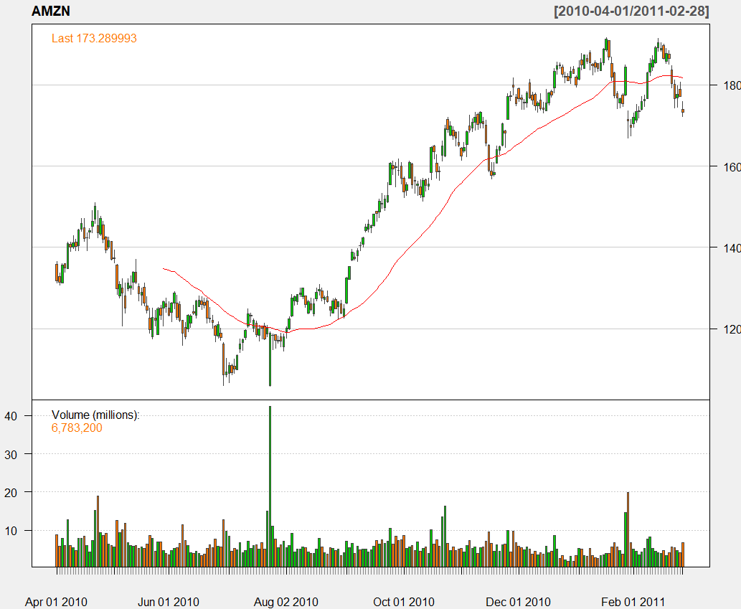
AMZN prices rom 4/1/10 to 2/28/11 with MA(40)

Slide 5
Using the trend line itself for signals
We know the purpose of the trend line is to smooth out noise and uncover the direction of prices.
Then it seems more reasonable to use the trend line to generate the trading signal:
Buy when the change in the trend line is up.
Sell short when the change in the trend line is down.
The penalty for using the trend line as a trading signal is its lag.
The benefit for using the trend line as a trading signal is that there are far few false signals (as in July and November).

Slide 6
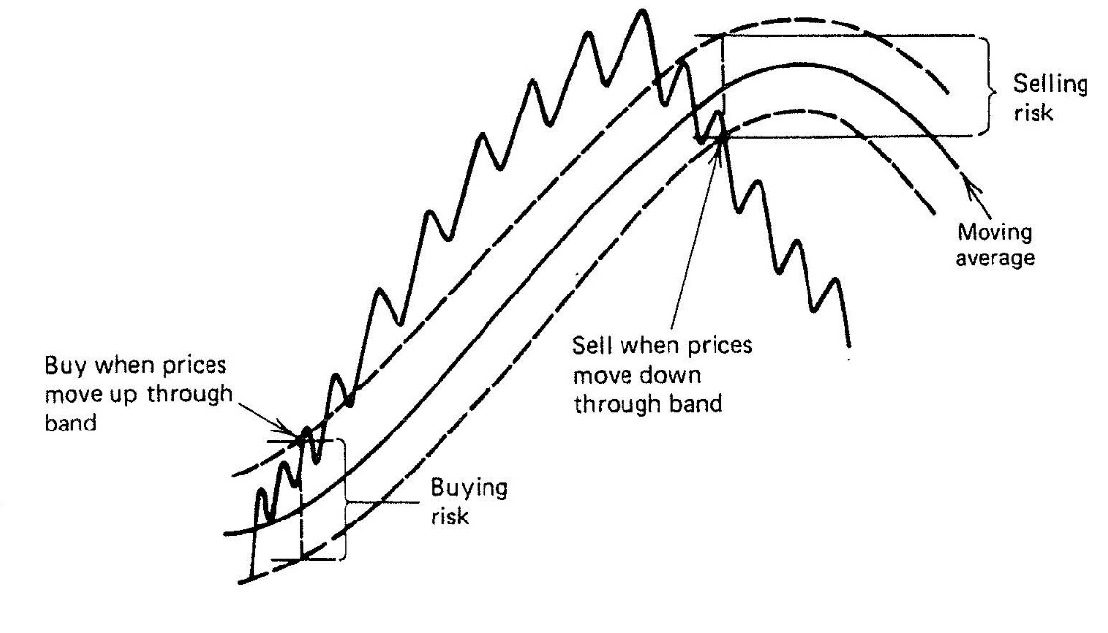
Bands and Channels
Construct a band, or channel, around the trend line to improve reliability
Bands will generally slow down trading.
The time of trend change is also the time of greatest indecision.

Slide 7
Bands Formed by Highs and Lows
The most natural band is one formed from the daily high and low prices.
Long positions are entered when today’s high crosses the average of the highs and short positions when today’s lows cross the average of the lows.
True range (TR) is a function that returns the maximum range from the combination of today’s high, low, and previous close: TR=max(H_{t}-L_{t}, H_{t}-C_{t-1}, C_{t-1}-L_{t}).
ATR(n) is the n-period average true range.
Could also use percentage bands around a moving average (e.g., 5% +/- MA)

Slide 8
Volatility Bands
In general, stock prices are more volatile when they are low, while commodity price volatility remains about the same.
Constructing a band that changes with volatility attempts to keep the sensitivity of the trend signals the same over time.
Examples:
B = MA +/- c * MA (percentage of trend line)
B= MA +/- c * p (percentage of price)
B= MA +/- s * ATR (average true range)
B=MA +/- s * stdev (standard deviation of returns or differences).
Bollinger Bands

Slide 9
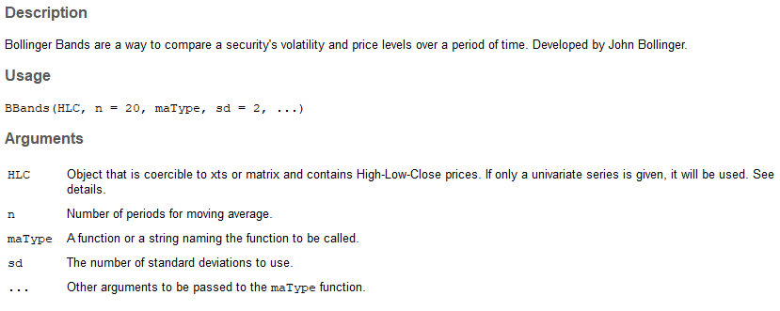
Bollinger Bands in the TTR Library

Slide 10
Rules for Using Bands: Always in the Market
Regardless of the type of band, rules for using bands to generate trading signals are similar. Typically:
Buy (close out shorts and go long) when the prices closes above the upper band.
Sell (close out longs and go short) when the prices close below the lower band.
The technique is always in the market with a maximum risk equal to the width of the band.
Alternatively, you may prefer to exit from each trade when prices cross the trend line midway between the bands.

Slide 11
Rules for Using Bands: Sometimes in the Market
With sometimes in the market, the bands are used to enter positions and the trend or centerline is to exit, So:
Go long when prices close above the upper band. Close out longs when prices reverse and close below the center of the band.
Sell short when prices close below the lower band. Cover shorts when prices close above the center of the band.
Allows trades to be reentered in the same direction in the event of a false trend change.
Risk is limited to half of the full band width. Narrow bands result in more frequent trades, while the converse is true for wider bands.

Slide 12
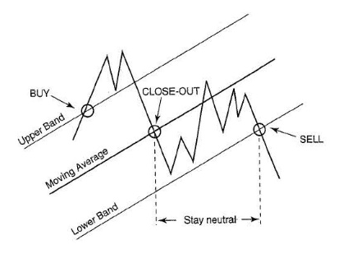
Sometimes in the Market: A Visualization

Slide 13
Class Workshop: Bollinger Bands
Implement the “sometimes in the market” approach.
We will walk through the Bollinger Bands Backtest Script
Make sure the universe is in the same directory
Since we may carry over open positions from one period to the next, we will need to enhance our backtest program to manage the record keeping.
Step through in RStudio, while I proceed in PowerPoint

Slide 14
Structure of the Backtest
Initialize and prepare the environment
Load the data and calculate the Bbands indicators
Generate Trading Signals from the indicators
Apply the trading rules:
Close out any positions for which we have a signal to do so. We don’t want to try to close out a position we don’t have.
Open new positions for any stocks that we have a signal to do so and that we don’t already have an open position.
Calculate portfolio statistics
Run the Backtest

Slide 15
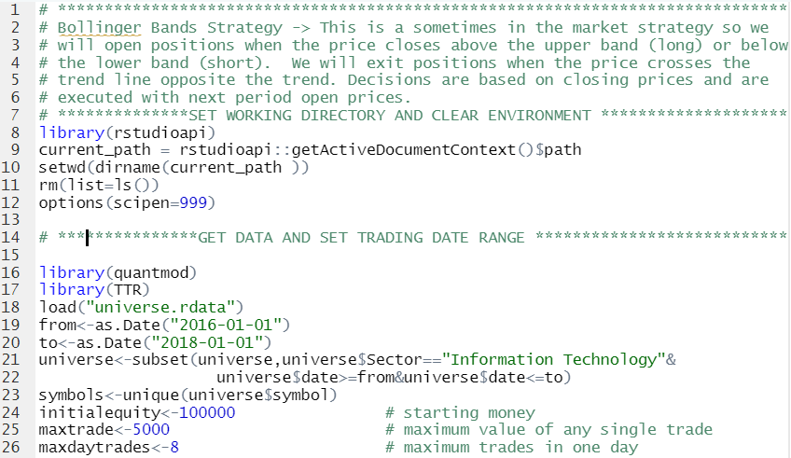
Initialize and Prepare the Environment

Slide 16
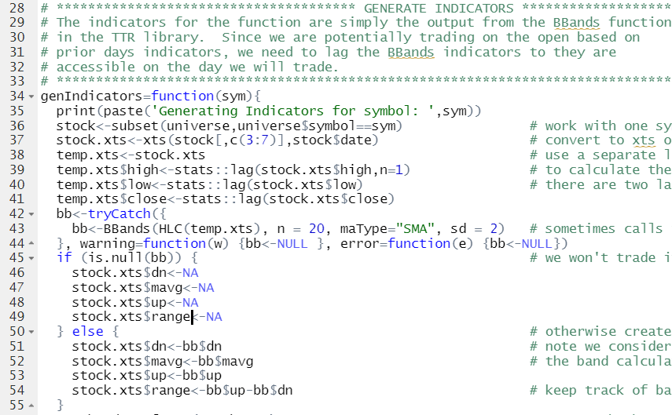
Generate Indicators

Slide 17
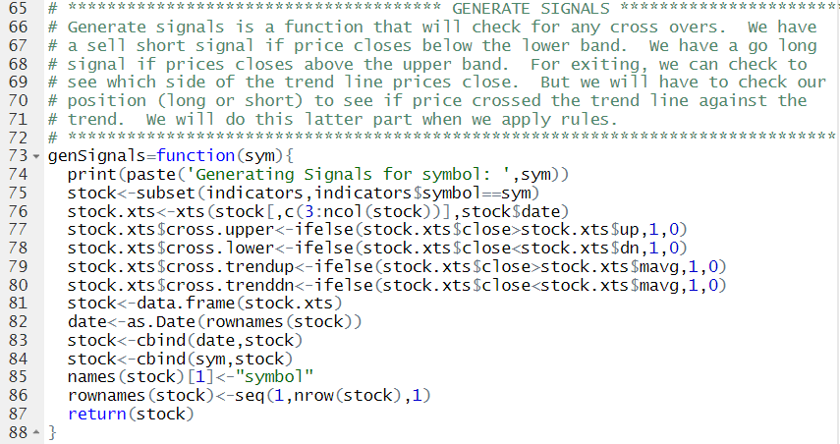
Generate Signals

Slide 18
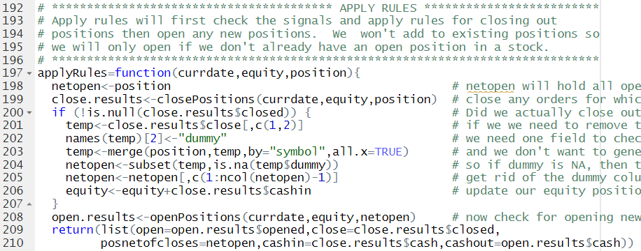
Apply Rules

Slide 19
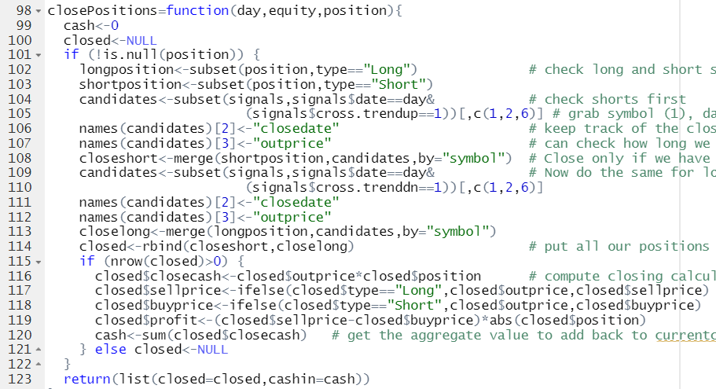
Close Positions

Slide 20
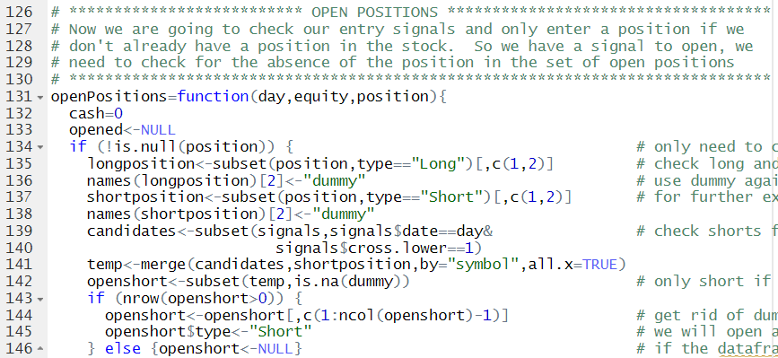
Open Positions Part 1: check for open short positions

Slide 21
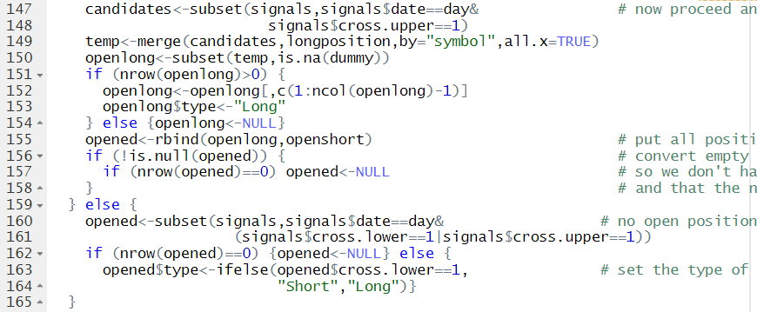
Open Positions Part 2: check for open long positions

Slide 22
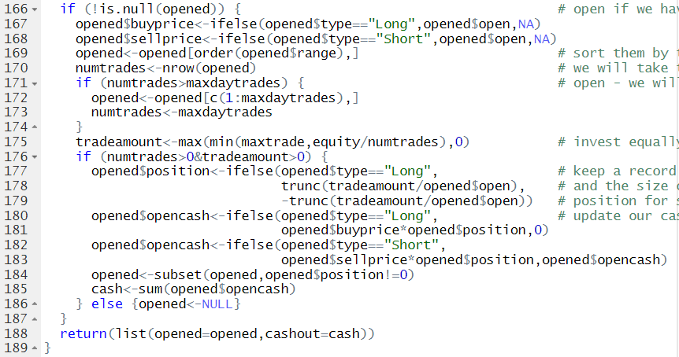
Open Positions Part 3: perform the opening

Slide 23
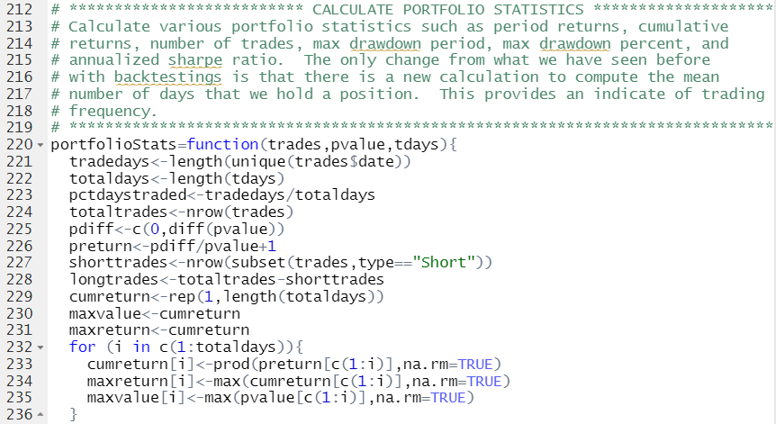
Calculate Portfolio Statistcs

Slide 24
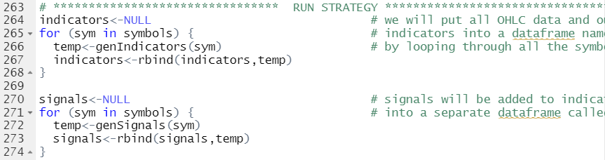
Run the Strategy Part 1: Indicators and Signals

Slide 25
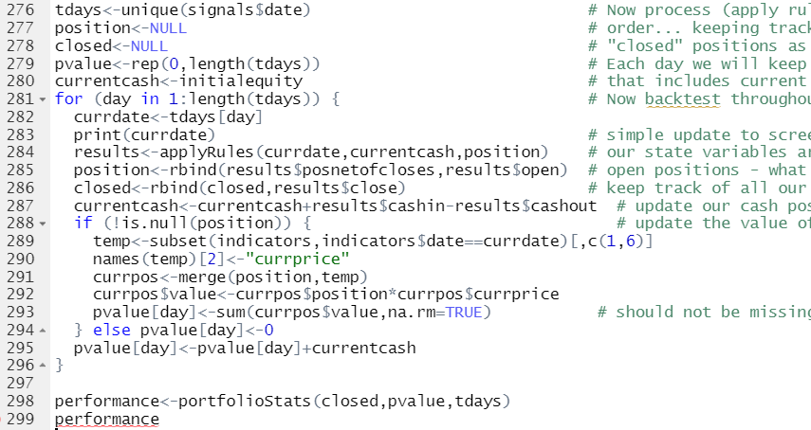
Run the Strategy Part 2: Loop and Apply Rules

Slide 26
The Compromise between Reliability and Profit
As with most trading techniques, the benefits of one approach can also have negative factors.
The use of a band around a trend line improves the reliability of the trading signal and reduces the total number of signals.
The wider the band, the fewer signals.
But, wider bands mean delayed entries; therefore you cannot capture as much of the trend and average profits will be smaller.
If the bands are too wide, profits can disappear. The use of wider bands also means greater risk on each trade. It will be necessary to trade smaller positions or capitalize the account with a larger investment.

Slide 27
Choosing the Trend Period
Arguably, determining the calculation period is more important to success than the method of identifying the trend in the first place.
Trends become clearer over longer time horizons.
Optimization and smoothing techniques.
Popular choices:
3 days, the expected duration of a short price move,
5 days, a trading week
20 to 23 days, a trading month
63 days, a calendar quarter,
252 days, a calendar year.
Trends can also be adaptive over time.

Slide 28
Moving Average Sequences: Signal Progression

Slide 29
Techniques Using Two trend lines
It is often the case that there is a dominant long-term trend driven by fundamentals.
Most traders, however, are not likely to hold a single long-term trade for the full period of the move.
Instead, use two trends: a fast one and a slow one. There are three popular methods:
Buy when the faster moving average crosses above the slower MA. Sell short when the faster moving average crosses below the slower MA.
Buy when the current price crosses above both MAs and close out long positions when prices cross below either MA. Sell short when the current price crosses below both MAs and close out short positions when prices cross above either MA.
Buy when the faster trend line turns up and the slower trend line is up. Sell short when the faster trend line turns down and the slower trend line is down. Exit the trade when the two trend lines are moving in opposite directions.

Slide 30
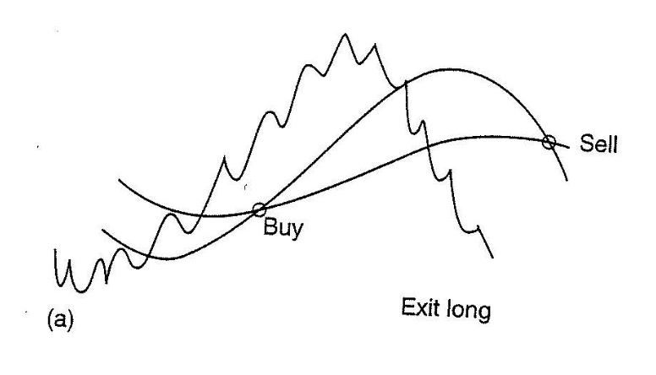
Method 1
Buy when the faster moving average crosses above the slower moving average. Sell short when the faster moving average crosses below the slower moving average.

Slide 31
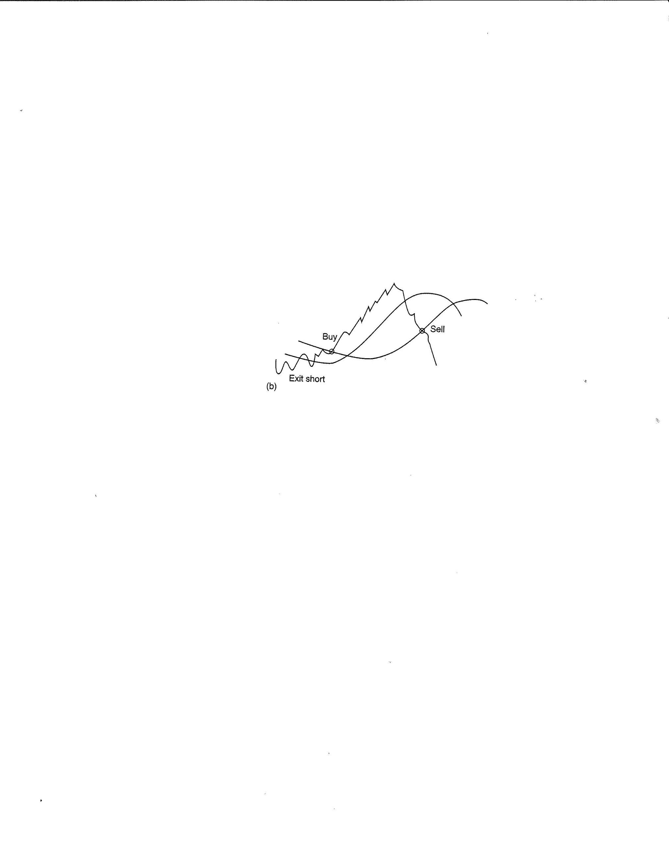
Method 2
Buy when the current price crosses above both moving averages and close out long positions when prices cross below either moving average.
Sell short when the current price crosses below both moving averages and close out short positions when prices cross above either moving average.
Exit long
neutral
neutral

Slide 32
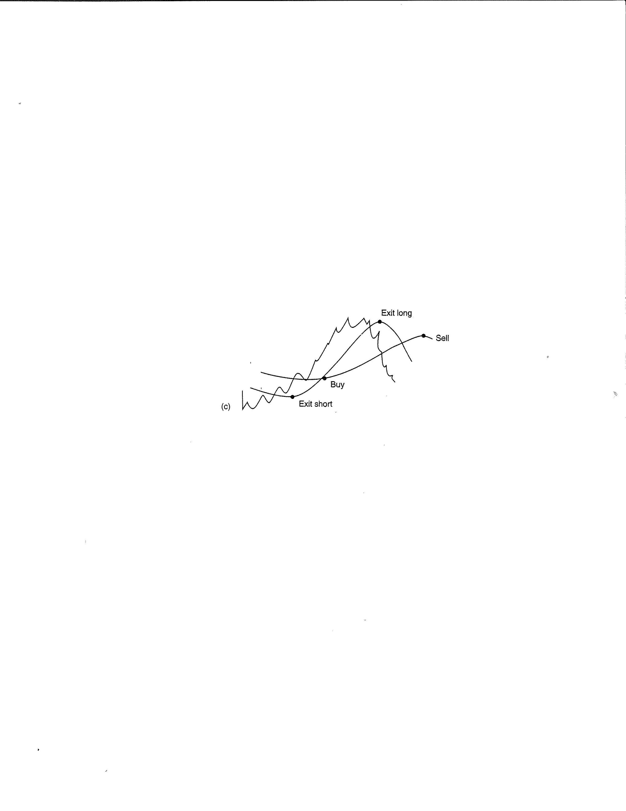
Method 3
Buy when the faster trend line turns up and the slower trend line is up.
Sell short when the faster trend line turns down and the slower trend line is down.
Exit the trade when the two trend lines are moving in opposite directions.

Slide 33
Class Exercise: Implementing a Two Trend Strategy
Choose any one of the three common two trend methods and create a backtest for it.
Use the Bollinger Band backtest provided to you as your starting point – it will be easier to simply modify, rather than create anew.
Use any trend calculations of your choice for each trend.
Think about what sections of the code will need to be modified? How will you do it? Why?
You should get as far as creating the indicators you will need and then generating the signals.
Please use the same backtest period and trading restrictions as in the Bollinger Band backtest, but I want you to do this for the energy sector.

Slide 34
Adding a Third Trend
Is there a rationale for more than two trends?
The justification arises from using slow moving averages. It may indicate a signal in one direction, when prices are actually moving in another.
A third, faster moving average can be used to confirm the direction and avoid entry into a trade that is going the wrong way.
Add the rule: do not enter a trade unless the confirming moving average is moving in the same direction as the position you want to enter.

Slide 35
Anticipated a Change in Trend
Systematic trading is most successful when you can execute an order as soon as possible.
Calculating your trading signals after the close of the market, then placing your order after hours or the next open, is going to return less than executing on the same close that you just used for your new signal.
One solution to this dilemma is to capture prices shortly before the close, generate the trading signals, then enter the buy and sell orders for execution on the close.
Occasionally, the order will be wrong because prices changed direction in the last few minutes of trading, but the cost of exiting the trade will usually be small compared to the overall improvement in execution.
As a general rule, entering sooner is better.

Slide 36
Anticipating a Change in Trend
Another alternative is to calculate, in advance, the closing prices that will generate a signal using either the trend line or the price-crossing method.
For an n-day moving average the calculation is simple.
If a 20-day average is used and the oldest prices was 30.25, then any price greater than 30.25 today will cause the trend line to move up.
Hence, a stop order can be placed shortly before the close to buy at 30.26.

Slide 37
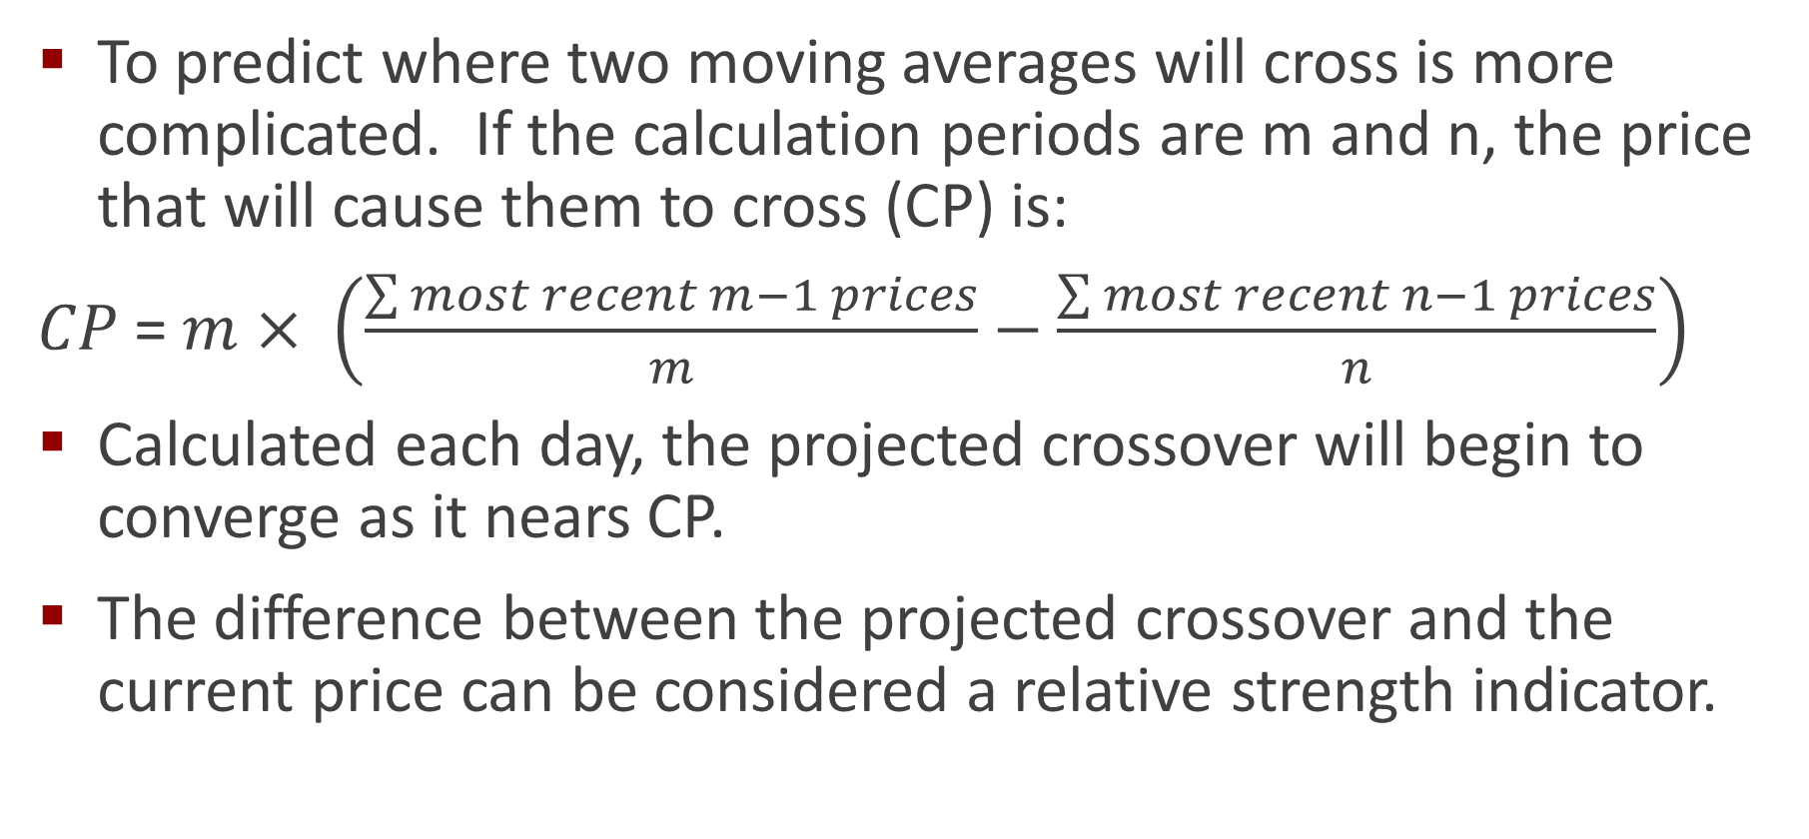
Projecting Moving Average Crossovers
To predict where two moving averages will cross is more complicated. If the calculation periods are m and n, the price that will cause them to cross (CP) is:
$CP$= $m$ $× \left(\frac{\sum{most recent m−1 prices}}{m}−\frac{\sum{most recent n−1 prices}}{n}\right)$
Calculated each day, the projected crossover will begin to converge as it nears CP.
The difference between the projected crossover and the current price can be considered a relative strength indicator.

Slide 38
Summary
Next Class: Momentum and Oscillators

